Slide 1
LU in People Search & Answer Using Tenant Context, and Hybrid trigger architecture
Shobhit Singh, Zhiguo Yu, Mehar Yeleti

Slide 2
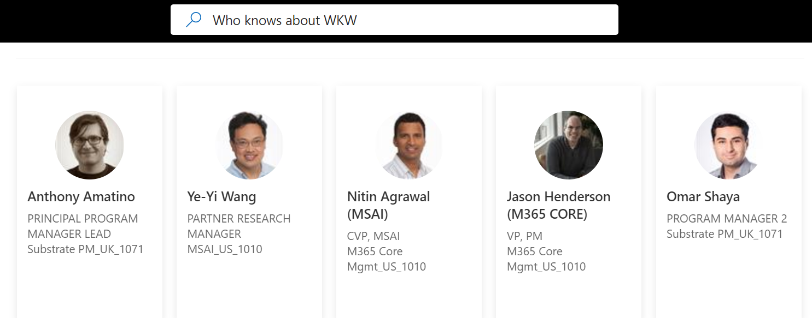
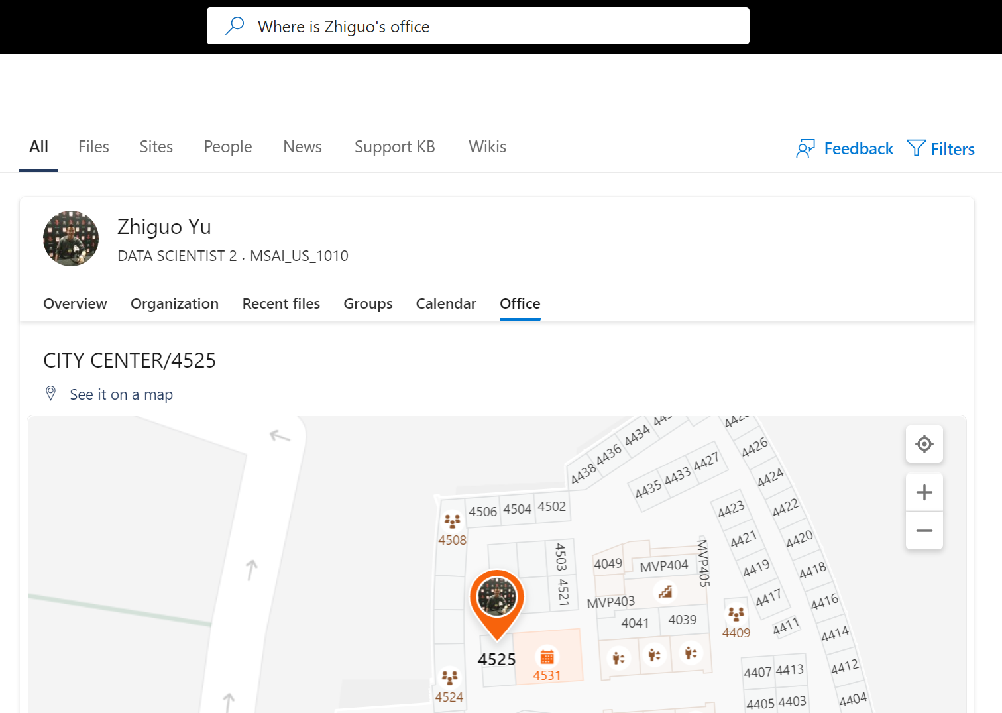
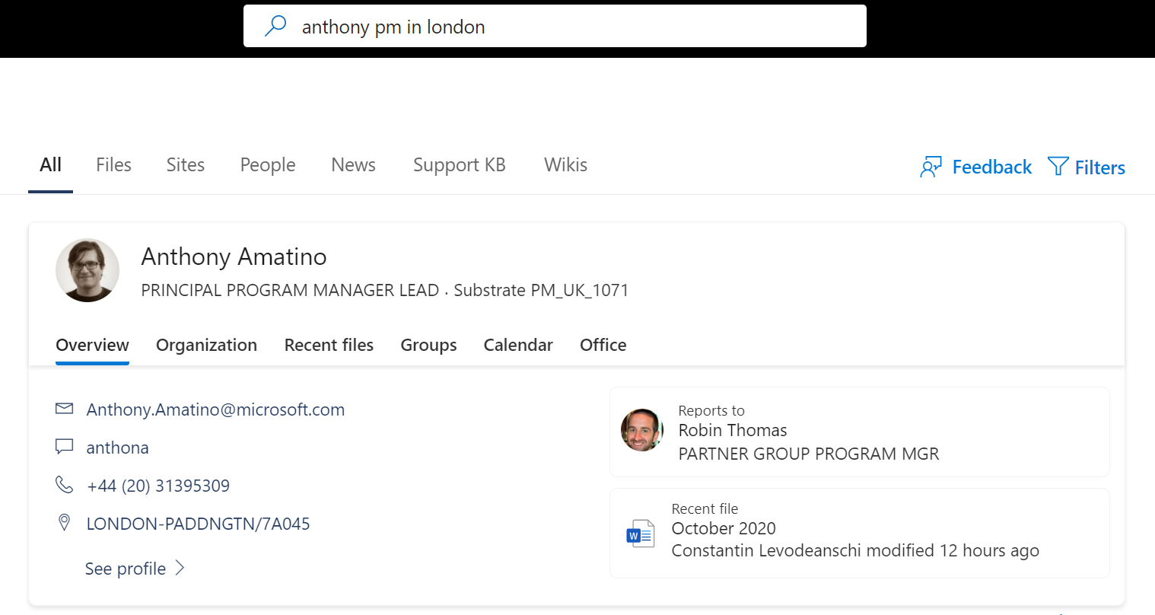
User jobs
Vision: “Naturally search for People or specific information about them”
Searching for a person/multiple-people
By combination of attributes (job_titles, locations, org names, expertise topics etc.)
Searching for information about a person
For information such as location, manager/Org chart etc.
Notes:
Finding people –
As a canvas for multiple cross-org initiatives such as Topic mining, WKW
Finding people through attribute filters
Finding information about People –
Examples –
Finding specific info about People you know.

Slide 3
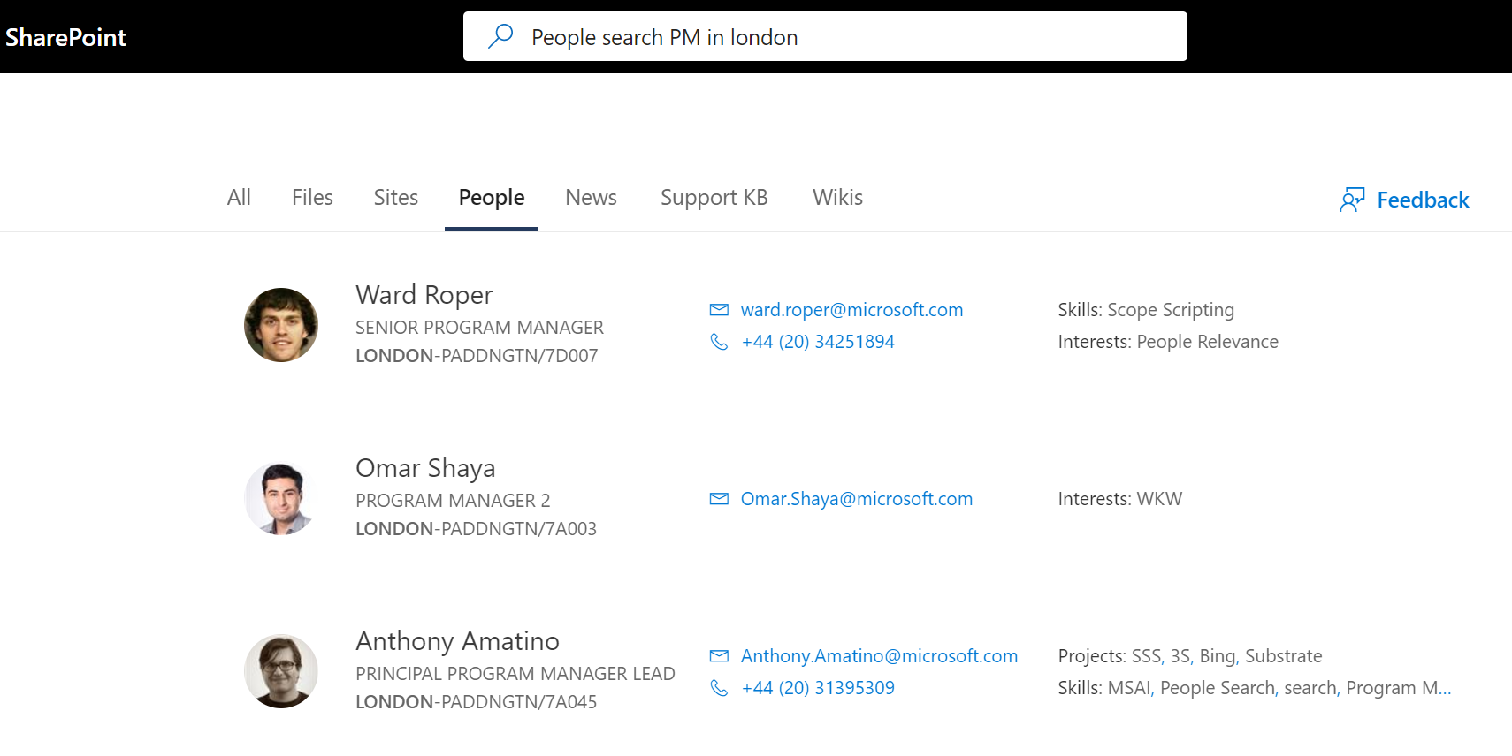
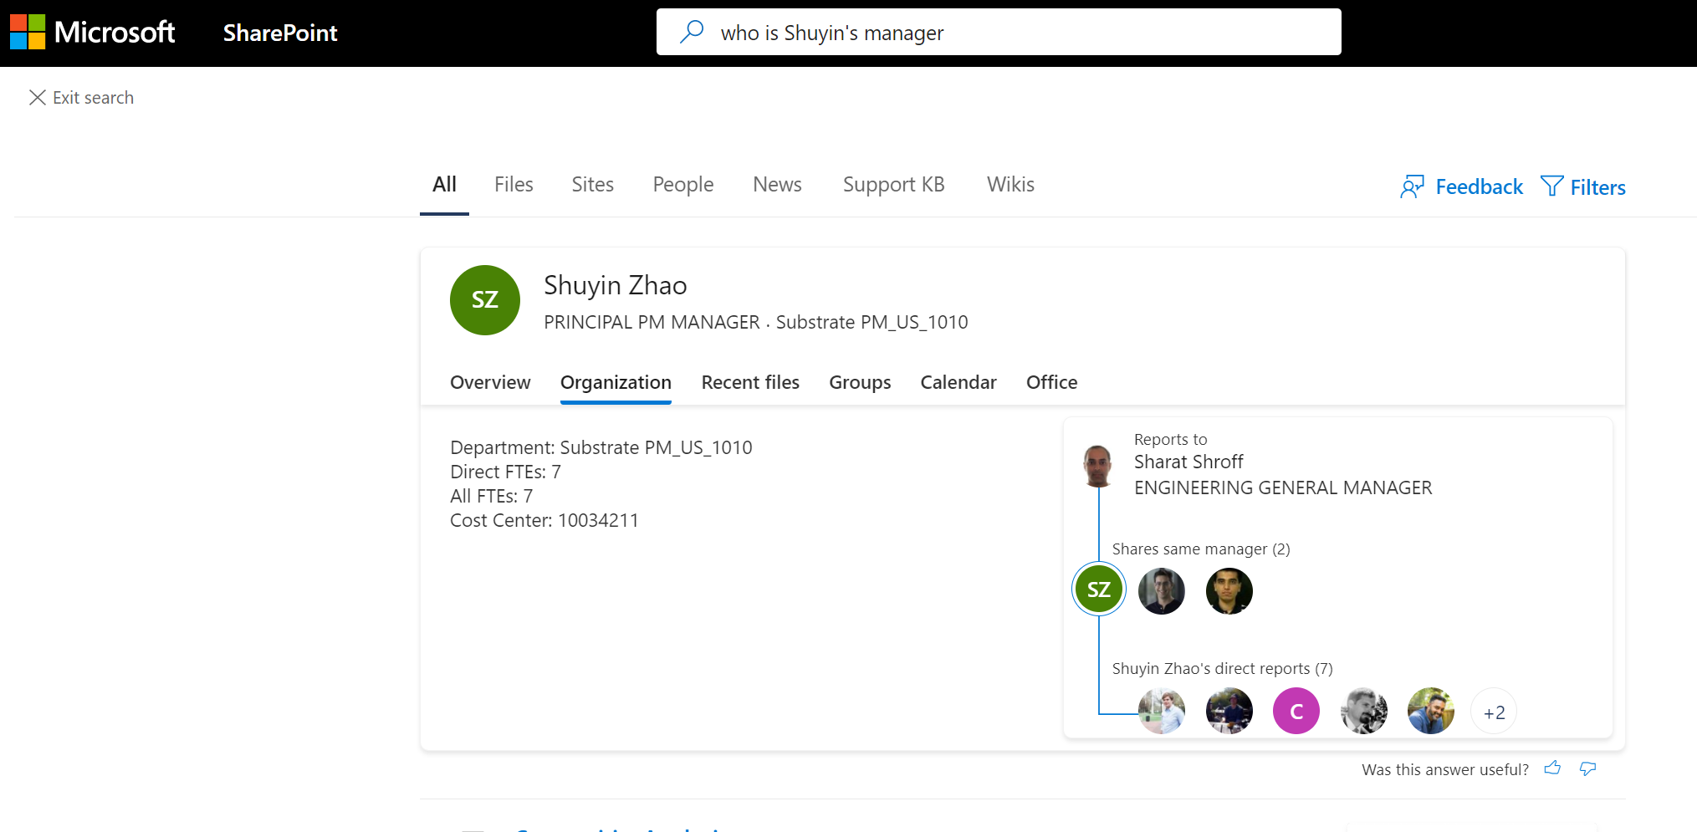
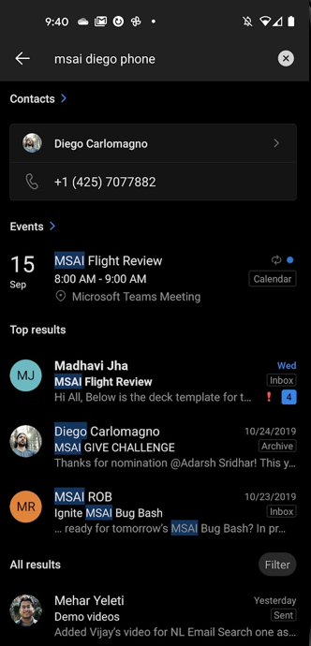
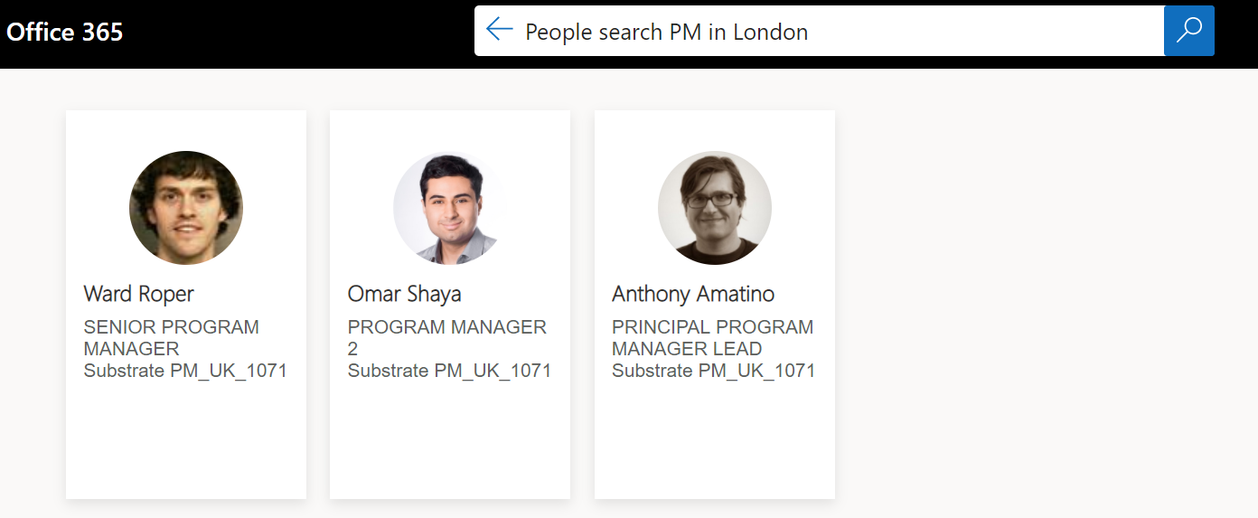
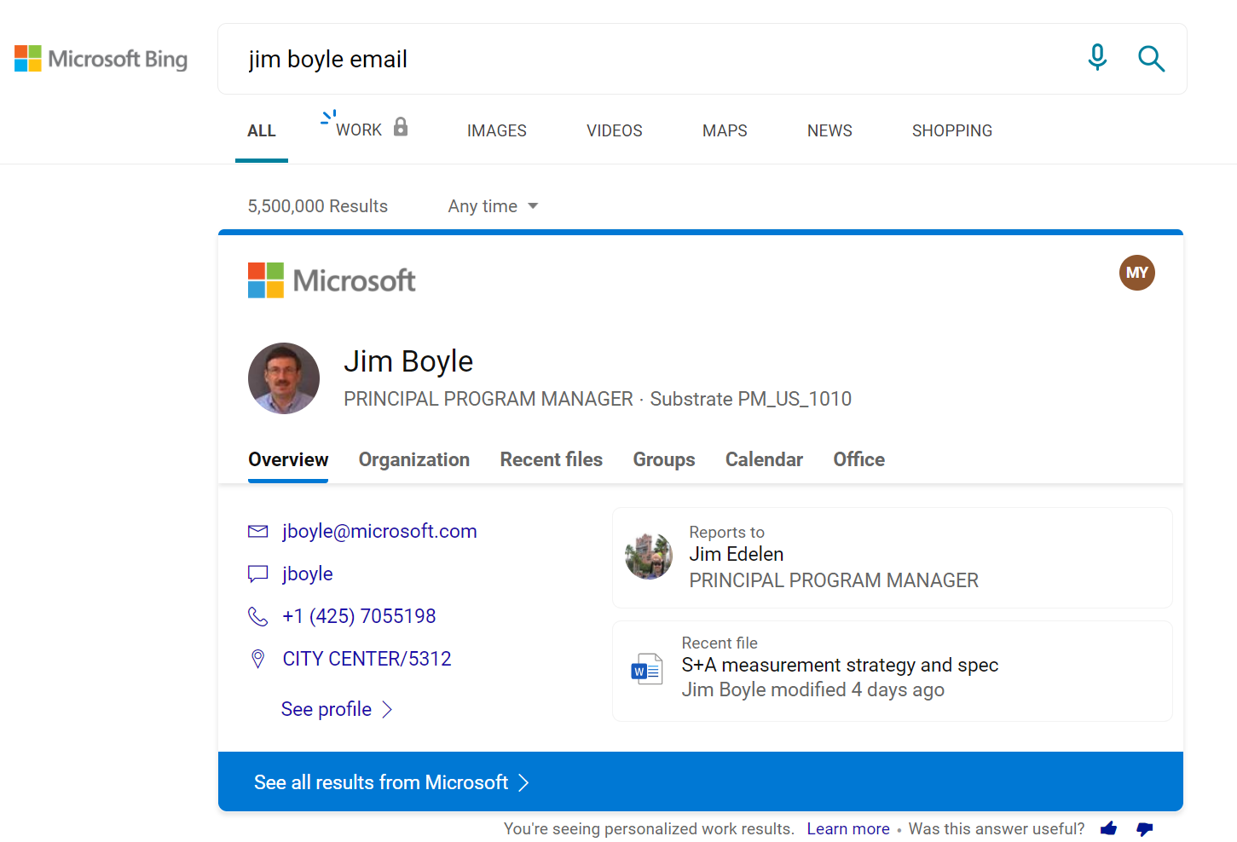
Canvases
CURRENT
Sharepoint.com (WW in Q2)
Outlook Mobile (WW in Q2)
UI Style: Answer card
UI style: SERP
Office.com (WW in Q2)
Bing.com (Web vertical WW in Q2)
UI Style: People Flash-in
FUTURE Teams Desktop & Mobile, Outlook desktop, OWA, MSB Work (Need alignment with partners)

Slide 4
People Relevance + LU partnership goals
Partnering with People Relevance team to create a hybrid trigger architecture, contextual signal pipeline, as well as improve mapping of LU output to People index attributes
LU
People Relevance
Statistical Intent/Slot understanding needed to expand the coverage and accuracy of People queries, since People grammar only has limited support of patterns
Domain classification to drive Whole Page Relevance
Contextual signals at Query Understanding layer
Low latency triggering for primary query patterns based on legacy People grammar by-passing QAS
People Index supporting name only type queries without NL
Result confidence (HC classifier)
Result Suppression/Ranking

Slide 5
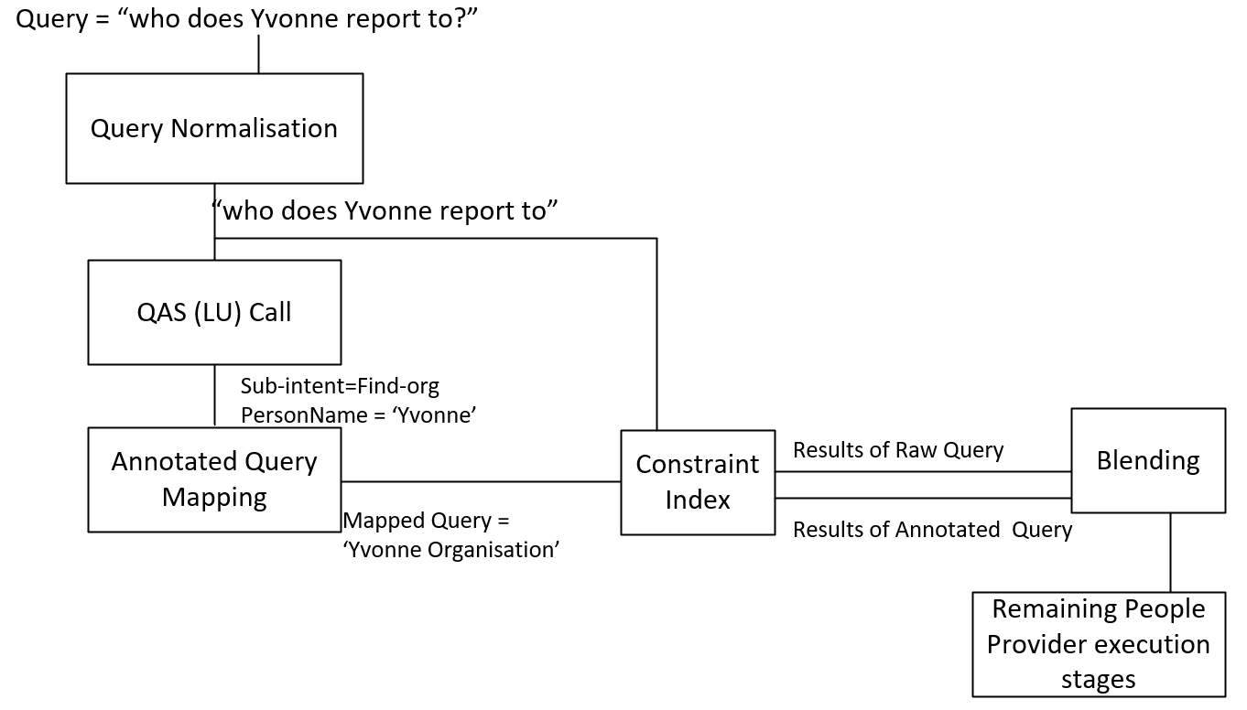
People Relevance + LU workflow
Hybrid workflow design
People Relevance workflow calls the LU model in QAS and get back People LU intent and slots
Map the LU annotated query to a format consistent with current People CI Grammar
Blend the results coming from CI using the (a) raw query, (b) LU annotated + mapped query in order to increase recall
if (R1 has results) return R1 without waiting for R2 else if (R2 has results) return R2 else return No Results end if
LU-People Integration Milestones (Web view)
Notes:
Initially the query is normalised
A call to QAS LU model is performed to retrieve the QAS annotated query with sub-intents and filled slots
In parallel the original query is sent to the People Index to retrieve a set of Results R1
The QAS annotated query is mapped to a Constraint Index specific translation and then sent to the Index to retrieve a set of results R2
Result sets R1 and R2 are blended
Blending strategy: If |R1| > 0, then return R1, else if |R2| > 0 return R2, else return {};
The remaining People Provider stages (Suppression/Ranking/HC Classification) are executed

Slide 6
LU Output in Annotated Query Mapping
Domain (confidence score)
Intents + slots (map NL queries to fixed people grammar pattern)
Input Query | Domain Confidence Score | People Answer Trigger
Mehar from Bellevue | 0.85 > 0.35 | Yes
Do I have any meeting | 0.15 < 0.35 | No
Input Query | Intent/Slot Used | Mapped Query | People Answer Trigger
Who does Yvonne report to | search org chart + contact name | Organization of Yvonne | Yes
What is Mehar’s office/phone/email | people attribute + contact name | Location/phone/email of Mehar | Yes
Who is Mehar the PM from Bellevue/MSAI | contact name + job title +office location/org name | Mehar the pm in Bellevue (from MSAI) | Yes
Devs who are working on deep learning | job title + skill name | Devs the expert in deep learning | Yes
Devs who are working on wkw | job title + project name | Devs who works on wkw | Yes
…
Who is Mehar from Shuyin’s team |  | Not supported | No

Slide 7
Offline evaluation (E2E)
Ground Truth
A list of scenarios are created based on current people grammar support
You want to find X working as Y in Z
Instantiated template from MSIT tenant lexicons
You want to find Mehar working as program manager in Bellevue
Judges come out NL search queries given these templates
In domain: 585 NL search queries
Out of domain: 2000 search queries from Bing
Metrics
Precision@N/Recall@N
Result
 | Precision@5 | Recall@5 | F1@5
People CI grammar | 88.72% | 36.15% | 51.36%
People CI grammar + LU | 87.05% | 54.32% | 66.9%

Slide 8
Challenges in People LU Modeling
Tag ambiguous slots with limited context
John from APOC (org name or office location?)
John who works in Café (org name, office location, or project name?)
Tenant lexicons (“domain knowledge”)
Noise can be introduced by current lexicon generation process
Tenant lexicons features need to be carefully trained
Jane from SR (SR should not be job title even if it only appears in job title tenant lexicon)
Job title: SR Software Engineer
LU to CI Mapped query
New slots/intents needs runtime changes
Complex NL queries
Mehar from Shuyin’s team (not supported by CI)
E2E quality with “perfect” LU output is estimated to be low (~60% Coverage)
End to end analysis with "Perfect" LU output (Web view)

Slide 9
LU Model Improvements Offline
End to End Quality
LU model quality only
 | Precision@5 | Recall@5 | F1@5 | AEther experiment
LU baseline (March 2020) | 85.54% | 45.31% | 59.24% | aether://experiments/dde1979e-2f45-48cb-840a-42a472893b3a
LU with Static MSFT Tenant Lexicon (In flight) | 86.32% | 53.23% | 65.85% | aether://experiments/46c335ba-9beb-46ef-bfd1-37ab2c98583e
LU with Dynamic Tenant Lexicon (In flight soon) | 87.05% | 54.32% | 66.9% | aether://experiments/1feff684-2528-4e74-8108-4c65084fc030
 | Query Precision | Query Recall | Domain Precision | Domain Recall | In domain Intent Acc | In domain Slot Acc (query level)
LU baseline (March 2020) | 22.75% | 31.85% | 61.77% | 86.48% | 73.52% | 42.42%
LU with Static MSFT Tenant Lexicons (In flight) | 35.76% | 43.7% | 77.12% | 94.26% | 83.89% | 50%
LU with Dynamic Tenant Lexicon (In flight soon) | 41.91% | 42.22% | 89.39% | 90% | 85% | 51.3%
All LU model training/test data shared in EN-US Modeling Resources (Web view)

Slide 10
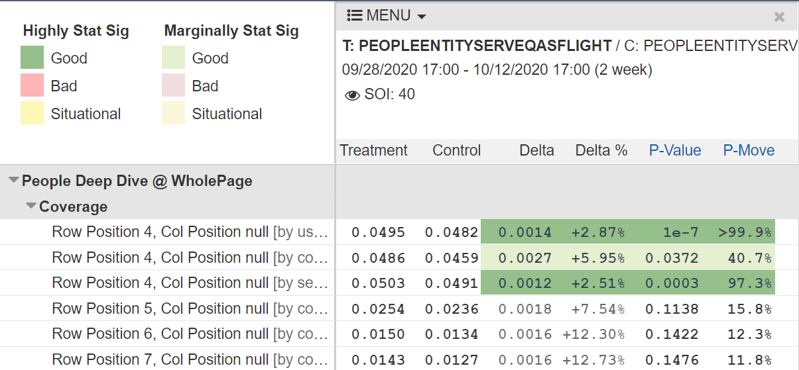
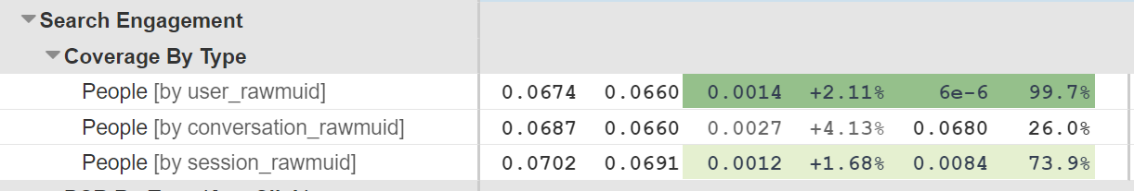
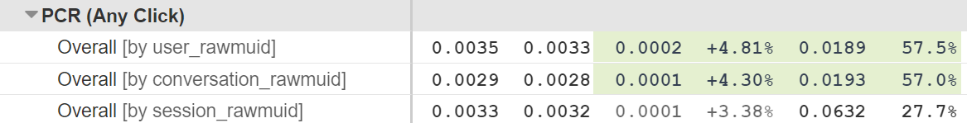
Online experiment results
After fixing over-triggering issues at the end of Q1 we re-ran the experiment. The current scorecard for our flight in MSO shows considerably positive lifts to Coverage and PCR. Similar flight ongoing in OM.
The coverage gains with People team’s multiple completions feature is expected to be even higher as it allows better mapping of LU output to People index (ref).
Notes:
Change to Overall metric.. Show position 1-3 as well..

Slide 11
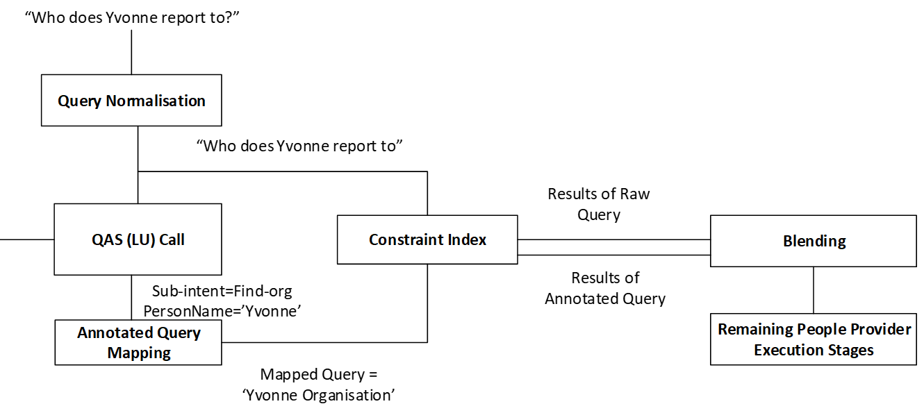
Tenant Context pipeline
Improve the Slot and Intent recognition capability of the LU model through dynamically (runtime) fetching the tenant-specific lexicon and including as features in QAS call
Tenant-specific Lexicon: Tenant Suggestions are used in order to generated a vocabulary with frequencies or probabilities of a token to be part of an attribute
“MSAI Diego Phone”
“MSAI Diego Phone”
Sample Lexicon
Tenant Vocabulary (SDS – Tenant shared)
token | p_department | p_first_name | p_job_title | p_office_location
msai | 0.7 | 0.04 | 0.1 | 0.16
software | 0.26 | 0.04 | 0.5 | 0.2
us | 0.3 | 0.04 | 0.15 | 0.51
QAS call (incl. Tenant lexicon)
QAS
Sub-intent=find_phone_number
PersonName=‘Diego’; Orgname=‘MSAI’
Mapped query = “Diego from MSAI Phone”
Contextual LU - People Answer - Design.docx

Slide 12
Modeling using Tenant signals
Tenant lexicon features included in modeling
Job title; department; first name, office location, skill, project
Training data generation
Collect query patterns from existed annotated data
<job_title> <contact_name> from <org_name>
Query expansion using query pattern and lexicons
P : the probability of slot replaced by a lexicon
N: the number of generated queries for each pattern
Generate data sets with
P from [0.1, 0.2, 0.3, 0.4, 0.5, 0.6, 0.7, 0.8, 0.9]
N from [20, 50, 100, 200, 300, 400, 500]
Models (CMF v1)
SVMs for Domain/Intent
LCCRF for slot model
Pick the model with the best LU quality on the test set
for domain/intent/slot models
Experiment 1: Model Retrain with CMF tool and Data Augmentation (Web view)

Slide 13
Tenant lexicon Impact
Model with tenant lexicons VS model without tenant lexicons (same training data)
 | Query Precision | Query Recall | Domain Precision | Domain Recall | In domain Intent Acc | In domain Slot Acc (query level)
LU baseline (March 2020) | 22.75% | 31.85% | 61.77% | 86.48% | 73.52% | 42.42%
LU with tenant lexicons | 35.76% | 43.7% | 77.12% | 94.26% | 83.89% | 50%
LU without tenant lexicons | 29.23% | 34.26% | 78.36% | 91.85% | 79.81% | 42.78%
Example of dynamic tenant lexicon model (Query: mehar from abc)

Slide 14
People LU roadmap
Q2
Flight goals: LU model 100% WW for en-US* in MSO/OM and MSB web.
Dynamic Tenant grammar usage: LU model + Tenant grammar pipeline changes in WW.
Model improvements:
New slots/sub intents to improve end-end coverage (E.g., what is Jane's office address -> where is Jane located, without usage of canonical value mapping)*
People Schema Change (Web view)
Joint intent slot modeling (might push to Q3)
Explore Compliant training
Domain classifier enhancements needed for WPR for People Centric Search
*Dependencies on STCA team for en* and Tier1 language rollout + New slot schema work
FY21 H2 Cobalt (Tentative)
Tenant lexicons quality improvement
Ensure identical experiences for Text and Voice based search endpoints
Rollout the base feature set to new endpoints – TM/TD/OD/OWA/MSB Work (Ongoing alignment discussion)

Slide 15
Thanks!

Slide 16
Appendix: People – LU hybrid architecture details

